Slide 1
Notes:
Intro slide with logo

Slide 2
Communications and Messaging

Slide 3
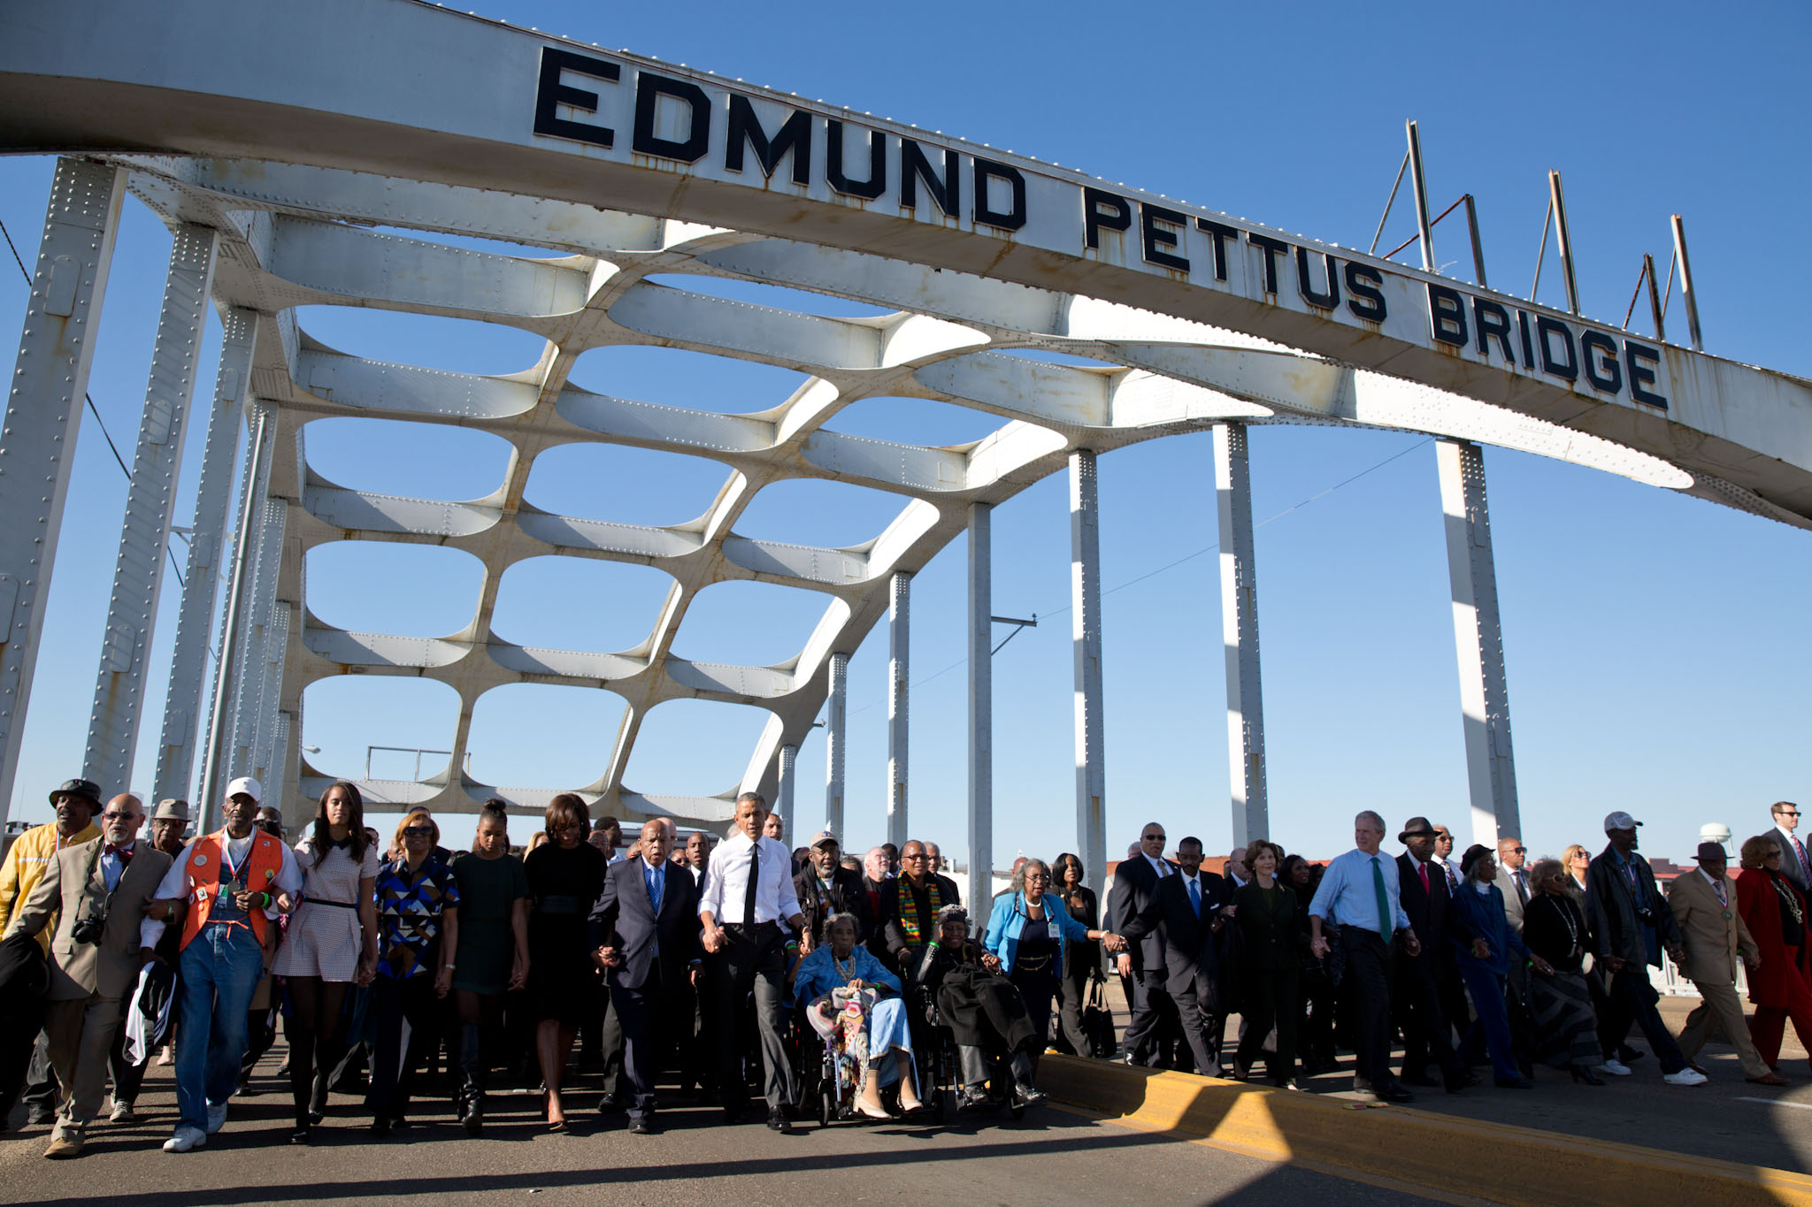
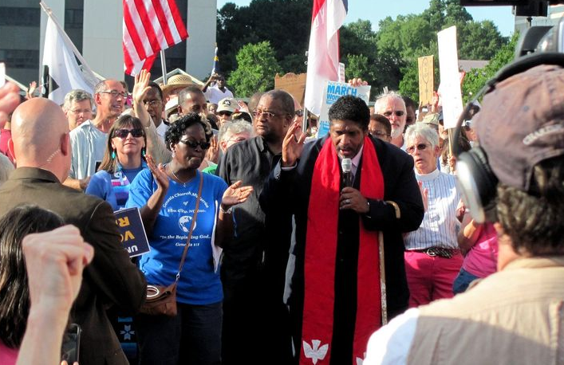
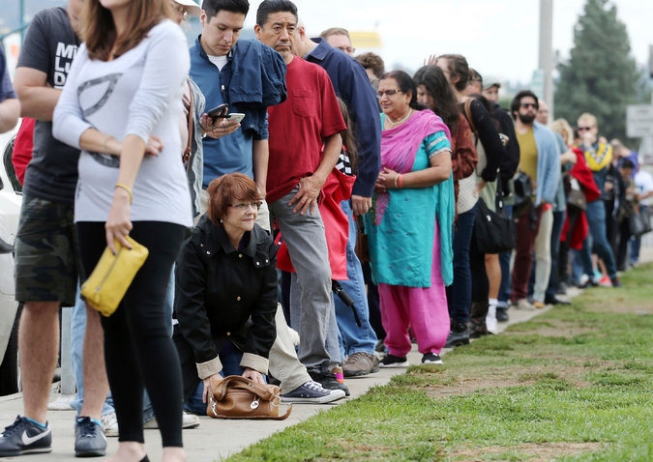
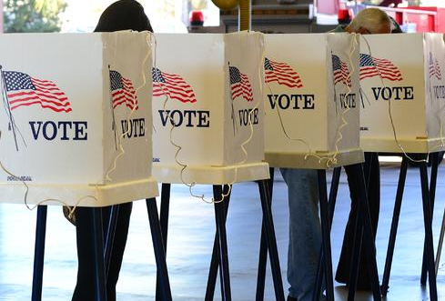
Current Climate
Notes:
Before going into the comms and messaging for PK. I want to take a step back and talk about our current climate which shapes our comms strategy and messaging.
Right now, we are fighting fears. With voting we are fighting fears of fraud. Fear of foreign interference in our elections. Fear of losing voting rights and power.
We also have an administration that is openly hostile to our communities and this commission is an example. If you are a person of color, queer, immigrant, every day is a reminder to us and the communities we are fighting for that we are not welcome.
And because of everything that is going on with Charlottesville, DACA and the hurricanes, it is hard to break through on voting issues. If you did a poll today on top issues for Americans, voting rights isn’t near the top. It’s the economy, jobs, healthcare. And when you are fight fears, under attack, you have this issue doesn’t rise to the top when it is so foundational to how we engage with government and build power in our communities, we have to take that into consideration.

Slide 4
Public Opinion
56% of Americans do not believe Trump’s claims that millions of non-citizens voted in the 2016 election (YouGov/Economist)
Despite that, 59% of voters are concerned with voter fraud in 2016 election and 65% in the next election (Morning Consult)

Slide 5
Challenges: Voter Fraud
Framing: Lead with Values
Our groups & spokespeople: What do we say?
Voter fraud is widespread in U.S. Elections.
Total | 31 |  | 11 | 19 |  | 56
Democrats | 44 |  | 18 | 14 |  | 45
Ind/DK | 26 |  | 7 | 16 |  | 59
Republicans | 19 |  | 5 | 26 |  | 67
Black | 25 |  | 12 | 22 |  | 63
LatinX | 23 |  | 7 | 17 |  | 69
AAPI | 36 |  | 11 | 15 |  | 54
White | 33 |  | 11 | 19 |  | 54
Notes:
A slim majority (56%) of voters think voter fraud is widespread.
African American (63%) and Latino (69%) voters are more likely than whites (54%) and AAPI (54%) to agree that it is
widespread in U.S. elections, but they may well have different definitions of “fraud.”
Face a narrative challenge that fraud is viewed as a truth, a public that might not be with us 100%, and a strong opposition message that we have to break through.
5

Slide 6
Communications Goals
Discredit and undermine the commission.
Lead with values and pro-voter solutions.
Notes:
So that is why we have had two goals for the PK commission.
Discredit and undermine the commission.
Highlight its lack of transparency, overreach into state and local authority, exposure of voters’ private info, and lacks bi-partisanship, This also provides an opportunity to show that this commission that does not align with American values.
Lead with values and pro-voter solutions
If we are going to cut through the noise, simply highlighting every thing this commission is doing wrong is not enough.
We have to provide our vision on how we improve elections and illustrate how those efforts encourage voter participation – which voter hold as a top value.

Slide 7
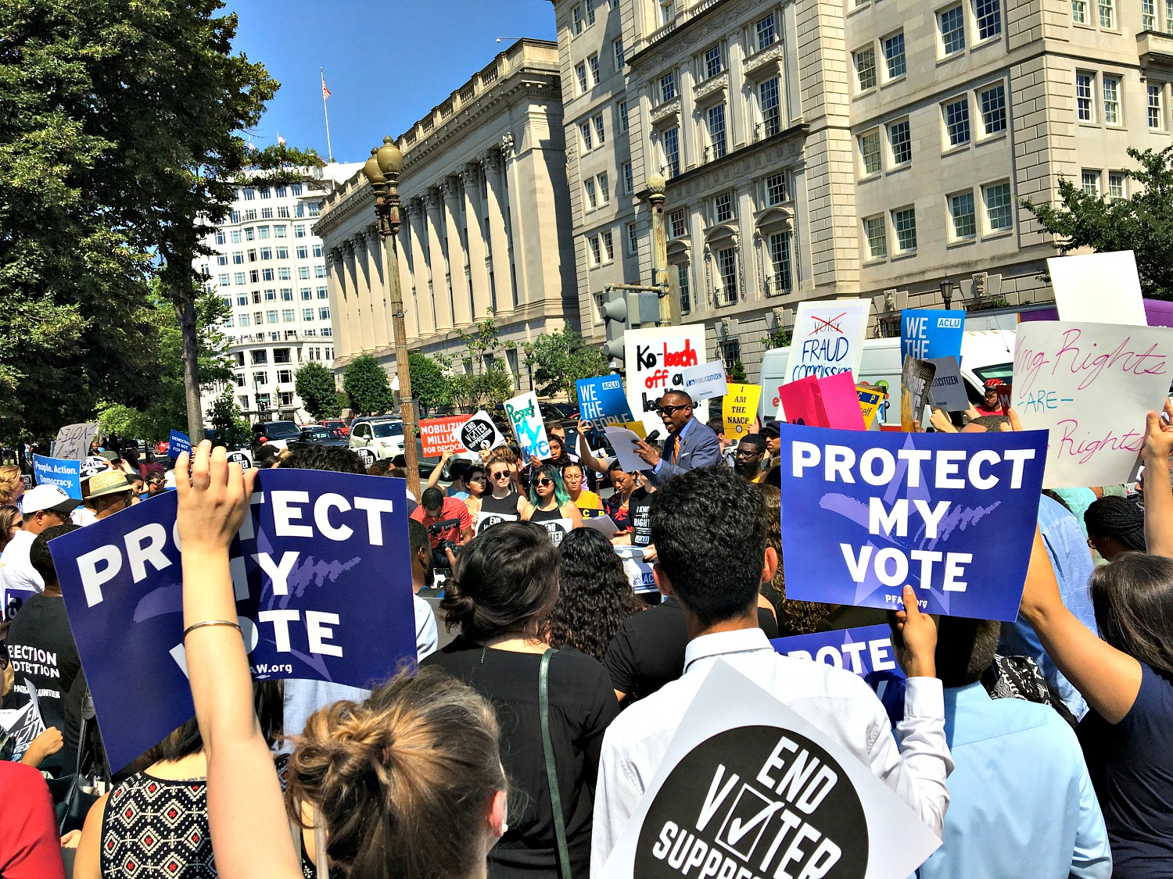
Framing: Values & Solutions
Our groups & spokespeople: What do we say?
Notes:
Slide 6: Values based messaging is the strongest strategy. Our top messages are freedom and democracy. People need some hope right now. When we lead with values then we can offer aspirational messages and why our solutions are best.
Also provides an opportunity. Lift up recent voting rights wins in the states and in the courts.
-This puts us on the offensive and the commission on the defensive. We can show how this commission is outside our values as Americans, our freedom to vote, and is not meeting the desire of the public to increase voter participation.
-It allows us to build the record of what policies we know have a proven record to secure our elections and raise voter confidence.
-Opportunity to lift up messengers like election officials and academics
7

Slide 8
Coordination And Planning

Slide 9
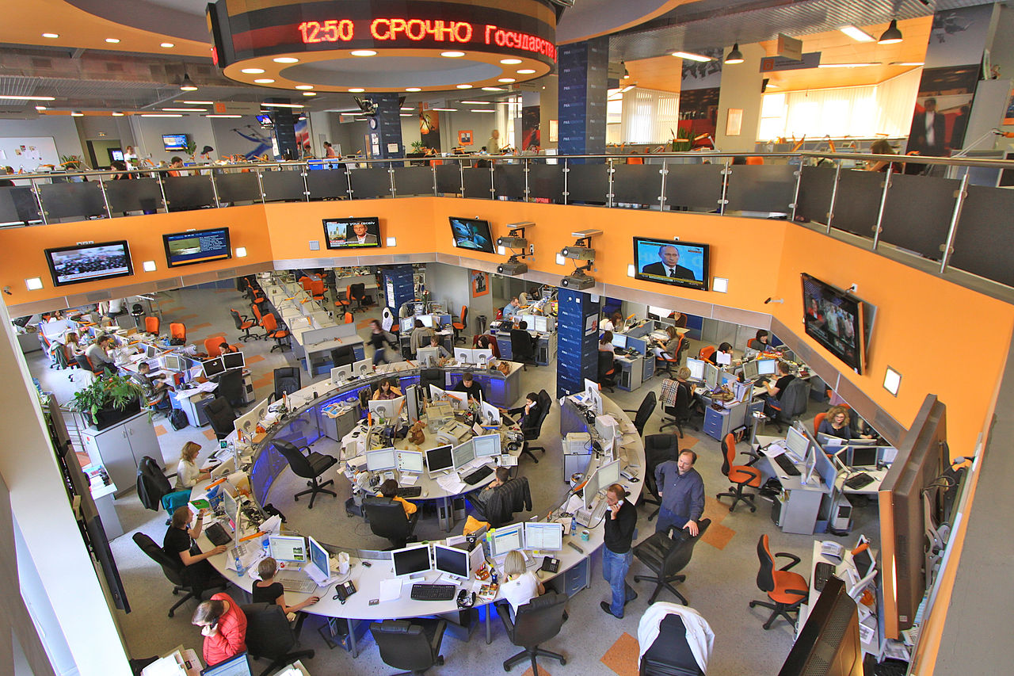
Deploying Media Strategies
Our groups & spokespeople: What do we say?
Notes:
-Rapid response comms meetings
-Develop gudiance so we have a unified message
-Other tools: social media and talking points
-This played out in the 1st commission meeting: The majority of articles lead with stories on the missteps of the commission, they are outside the effort to improve our elections and increase participation and because we had a unified voice especially on social media: #RespectmyVote trended nationally throughout the day so online our message was breaking through.
9

Slide 10
What’s Next?
Election Day
Inauguration
Notes:
Media audit to better understand the media landscape over the last 1.5 years and develop benchmarks and goals with the community to move the need, continued strategy meetings, building our frame and solutions as we look towards 2018 and beyond.

Slide 11
Questions
Notes:
Still some questions we have:
Pence-Kobach is a rapid response moment for us and this is a battle in the greater war. To what degree is this fight where we should be fighting a messaging battle on voting rights?
Is it resonating with people?
Do people know what Pence-Kobach is? Testing mentality.
When a commission continues to spread what we know is a lie but public believes is a truth – how do we counter the fraud narrative
11

